Slide 1

File Handling

Slide 2
Introduction
Data stored in the program are temporary;
It get lost when the program terminates
To permanently store the data created in a program,
Need to save them in a file on a disk or other permanent storage device
The file can then be transported and read later by other programs

Slide 3
Introduction
File Handling
Way to handle the files stored on the hard disk
So that we can, read and write the data in file
Java provides java.io package
Contain all class that help in performing input and output operations on files

Slide 4
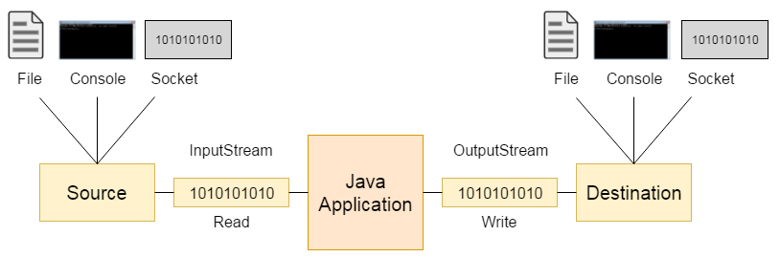
Java Streams
Stream
A stream is a sequence of data.
In Java, a stream is composed of bytes called a stream
Stream represent Source( which generate the data in form of streams) and Destination (which consume or read data available on stream)
In java.io package all classes are divided into two type of streams
1- Character Stream
2- Byte Stream

Slide 5
Byte Stream (100111010111101011101)
Raw sequence of 0's and 1’s to represent data
The data belong to either audio, video or text.
Just read/write data in form of 8bits(byte by byte)
The classes that handle Byte Stream and which are descendent of
java.io.InputStream
java.io.OutputStream
java.io.RandomAccessFile
BufferedInputStream
BufferedoutputStream
ByteArrayInputStream
ByteArrayOutputStream
DataInputStream
DataOutputStream
FileInputStream
FileOutputStream
PrintStream

Slide 6
Character Stream (11110110 11010101 101010101)
Character Stream is based on Byte stream, and bunch of 16 bits are picked as character
Data must be characters
Characters are encoded using a character encoding scheme such as Unicode
The classes that handle Character Stream and which are descendent of
java.io.Reader
java.io.Writer class
BufferedReader
BufferedWriter
CharArrayReader
CharArrayWriter
FileReader
FileWriter
InputStreamReader
OutputStreamWriter
PrintWriter
StringReader
StringWriter

Slide 7
File Class
The File class contains the methods for obtaining the properties of a file/directory
and for renaming and deleting a file/directory.
Absolute file name(full name)
Contains a file name with its complete path and drive letter
Example “c:\book\Welcome.java”
Relative file name (In relation to current directory
The complete directory path for a relative file name is omitted
Example: Welcome.java is a relative file name. If the current working directory is c:\book
Do not use absolute file names in your program

Slide 8
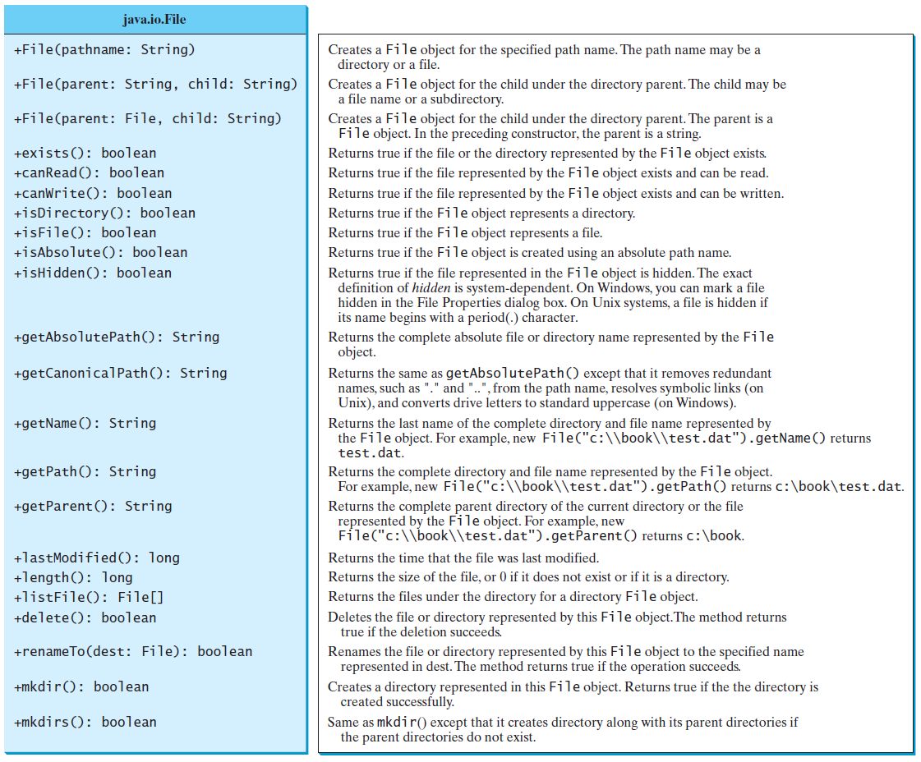

Slide 9
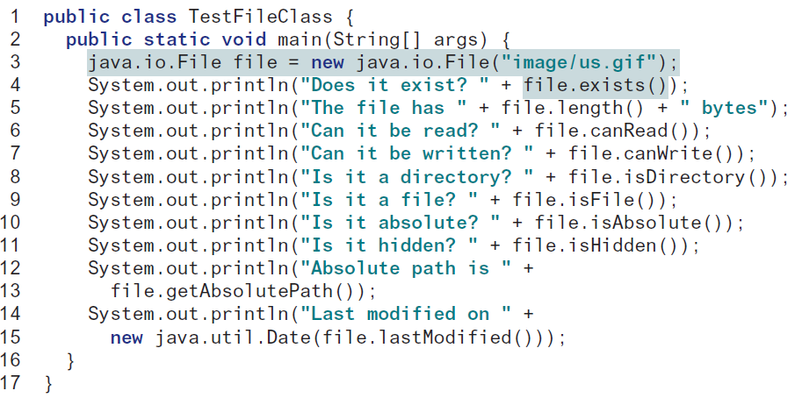

Slide 10
File Input and Output
Use the Scanner class for reading text data from a file and the PrintWriter class for writing text data to a file.
A File object encapsulates the properties of a file or a path
Does not contain the methods for writing/reading data to/from a file
Referred to as data input and output, or I/O
To perform I/O
Create objects using appropriate Java I/O classes

Slide 11
Writing Data Using PrintWriter
The java.io.PrintWriter class can be used to create a file and write data to a text file
Can use print, println, and printf methods on the PrintWriter object to write data to a file

Slide 12
Writing Data Using PrintWriter

Slide 13
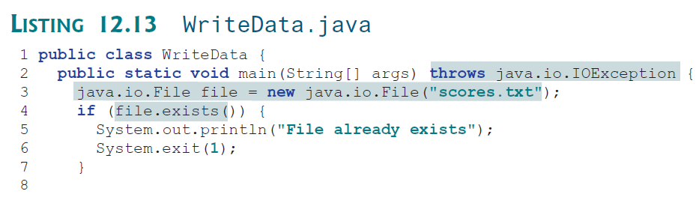
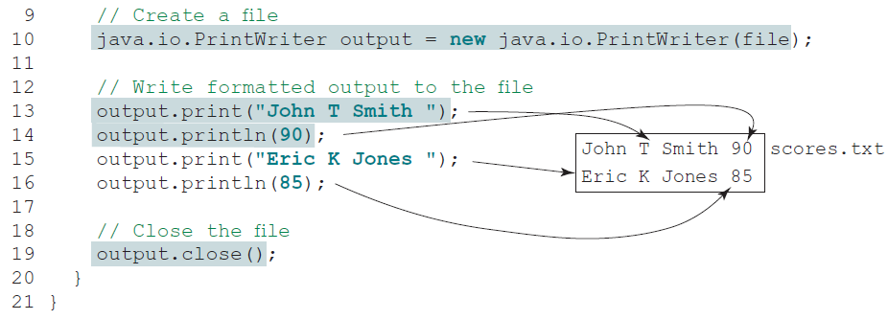

Slide 14
Try-with-resources
Programmers often forget to close the file. JDK 7 and above provides the followings new try-with-resources syntax that automatically closes the files.
try (declare and create resources) {
Use the resource to process the file;
}
try( PrintWriter output = new PrintWriter(file); )
{
output.print("John T Smith ");
output.println(90);
output.print("Eric K Jones ");
output.println(85);
}

Slide 15
Reading Data Using Scanner
To read from keyboard
Scanner input = new Scanner(System.in);
To read from file
Scanner input = new Scanner(new File(fileName));

Slide 16
Reading Data Using Scanner

Slide 17
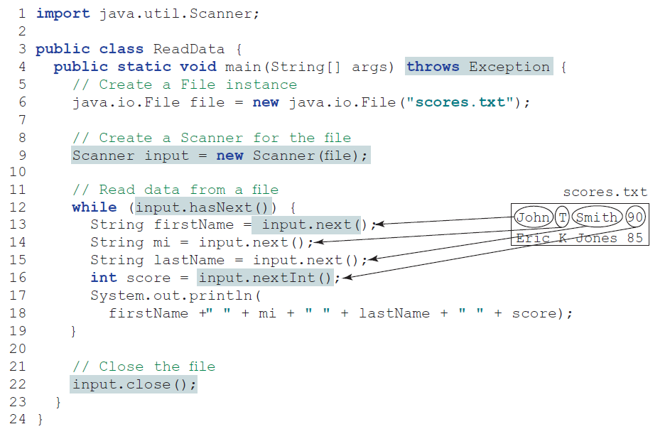

Slide 18
public static void main(String[] args){
try{
File file = new File("name1.txt");
Scanner input = new Scanner(file);
while(input.hasNext()){
String fName = input.next();
String mName = input.next();
String lName = input.next();
int age = input.nextInt();
System.out.println(fName+" "+mName+" "+lName+" "+age);
}
input.close();
}catch(IOException e){
………………………………………………………………………………………………………….
}
}

